Slide 1
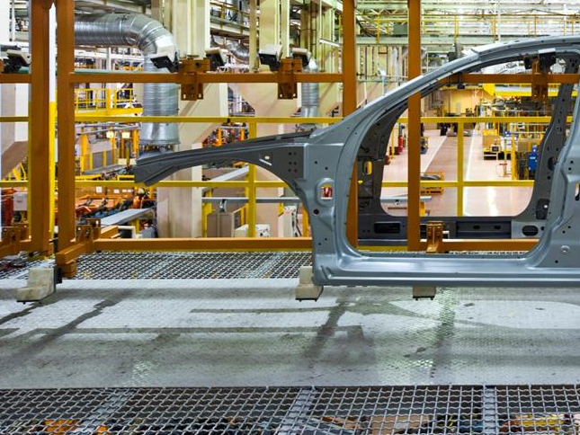


Seminarium
  Potrzeby modelowania na użytek zarządzania automatyką przemysłową.
  Potencjał współpracy praktyki z nauką.
  Tomasz Kibil
  EY – Advisory
  25 listopada 2014

Slide 3
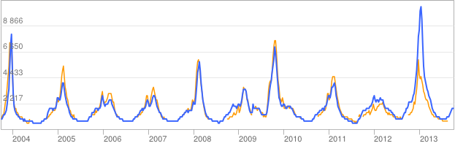
Google Flu Trends

Slide 4
Paradigm change
„This is a world where massive amounts of data and applied mathematics replace every other tool that might be brought to bear”
[
]
[
]
"All models are wrong, but some are useful."
George Box
"All models are wrong, and increasingly you can succeed without them”.
Peter Norvig
HYPOTHESIS
FACTS: Collected data
Theory analysis, assumptions, modeling, sample selection
Massive data
Analysis
Observations
Correlations
Result collection, hypothesis verification for selected sample and model
Confirmation
Error or conditional acceptance
Theory / Root cause model
FACTS: CORELLATIONS
STATISTICAL CONFIDENCE
+Precision
- Statistically correct sample
- Knowledge necessary for hypothesis formulation and modeling
+ Accuracy
+ New dependencies based on observed corellations
+ Holistic view
+ Mathematically proven
- No root-cause model
- Limited support for phenomenon understanding

Slide 5
Wisdom
Understanding
Knowledge
Information
Data

Slide 6
Ability to perceive and evaluate the long-run consequences of behavior
Wisdom
Why?
Understanding
How to make it work in desired way?
Knowledge
Who? What? Where? When? How many?
Information
Data
Observations

Slide 7
Wisdom
Understanding
Can be expressed formally
Expressed through action-based skills
Explicit
Knowledge
Tacit Knowledge
Information
Data

Slide 8
Action
Area of education
Wisdom
Area of faith
Understanding
Believes
Explicit
Knowledge
Tacit Knowledge
Area of training
Information
Area of experience
Data

Slide 9
Action
Wisdom
Understanding
Believes
Explicit & Tacit observations
Explicit
Knowledge
Tacit Knowledge
Experiments
Information (theory based)
Information (statistical confidence)
Modeling
Statistics & Corelation
Data
Data

Slide 10
Action
Wisdom
⬇
Understanding
Believes
Explicit & Tacit observations
⬆
⬇
Explicit
Knowledge
Tacit Knowledge
Experiments
⬆
⬆
⬇
Information (theory based)
Information (statistical confidence)
⬇
Modeling
Statistics & Corelation
⬆
Data
⬆

Slide 11

A system is a whole consisting of two or more parts that satisfies the following five conditions:
The whole has one or more defining properties or functions
Each part in the set can affect the behavior or properties of the whole
There is a subset of parts that is sufficient in one or more environments for carrying out the defining function of the whole; each of these parts is necessary but insufficient for carrying out this defining function
The way that each essential part of a system affects its behavior or properties depends on (the behavior or properties of) at least one other essential part of the system
The effect of any subset of essential parts on the system as a whole depends on the behavior of at least one other such subset
Russell Ackoff

Slide 12
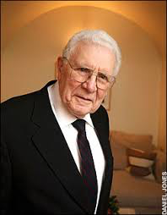
Performance of the system
Because properties of the system derive from the interactions of their parts, not their actions taken separetly,
when the performances of the parts of a system, considered separately, are improved, the performance of the whole may not be (and usually is not) improved.
Rusell Ackoff

Slide 13
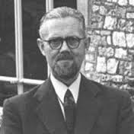
Law of Requisite Variety
"variety absorbs variety, defines the minimum number of states necessary for a controller to control a system of a given number of states."
William Ross Ashby

Slide 14
Systems Analysis and Synthesis
Systems Analysis
Systems Synthesis
something that we want to understand …
First take apart
First identify as a part of one or more larger systems
Understand the behavior of each part of a system taken separately
Understand the function of the larger system(s) of the which system is the part
Understanding of the parts of the system to be understood is then aggregated in an effort to explain the behavior or properties of the whole
Understanding of the larger containing system is then disaggregated to identify the role or function of the system to be understood

Slide 15











Upstream Operations
Midstream Operations
Downstream Operations
Foreign Imports
Collection Terminal
Processing Plants
Pipeline Networks
Liquefaction
Refineries / Petrochemical Plants
Primary Distribution Terminal
Tanker, Pipeline, Rail
Pipeline
Pipeline
Pipeline, Rail, Road
Pipeline, Rail, Road
Exploration & Production
Offshore Fields
Regional Service Provider Facilities
Operator
Facilities
Support
Services &
Facilities
Secondary Distribution
Terminal
Pipeline
Tanker, Pipeline, Rail
Tanker, Pipeline
Road
Exploration & Production
Onshore Fields (e.g., tar sands, shale plays)
LNG Tanker
Bulk Export to Foreign Markets
Industrial Wholesale
Consumer Retail
Tanker, Pipeline, Rail
Pipeline
Regasification
Pipeline
Pipeline, Rail, Road
Pipeline Networks
Note: Inbound and outbound materials/chemicals, services, and people flow between support facilities and upstream, midstream, and downstream operations
Denotes flow of petroleum products

Slide 16
OEE – overall equipment effectiveness
Unpaid time
Planned shutdown
Availability
Not required for Production (in Paid time)
Planned Downtime / External Unplanned Loss
X
Performance
Downtime loss
Breakdown loss
Minor stop loss
X
Quality
Speed loss
Plant operating time
Speed loss
Plant production time
Production rejects
=
OEE
Quality loss
Operating time
Rejects on startup
Net operating time
Earned time
Productive time
Typical for manufacturing plants less then 60%. Top players up to 85%

Slide 18
Different optimisation theories
Program | Six Sigma | Lean Thinking | Theory of Constraints | Reliability Technology
Theory | Reduce Variation | Remove Waste | Manage Constraints | Operational Reliability
Application guidelines | 1. Define 2. Measure 3. Analyse 4. Improve 5. Control | 1. Identify value 2. Identify value stream 3. Flow 4. Pull 5. Perfection | 1. Identify constraint 2. Exploit constraint 3. Subordinate process 4. Elevate constraint 5. Repeat cycle | 1. Set system boundaries 2. Identify losses from perfection 3. Determine Financial Value 4. Loss Based Improvement Plan 5. Execute / Put in DMS
Focus | Problem Focused | Flow Focused | System Constraints | Asset Utilisation
Assumptions | A problem exists Figures and numbers are valued System output improves if variation in all processes is reduced | Waste removal will improve performance Many small improvements are better than system analysis | Emphasis on speed and volume Uses existing systems Process Interdependence | Dependency between failure modes (Competing Causes) Reliability/cost relationship is significant Focus on Uptime Incorporates best components
Primary Effect | Uniform process output | Reduced Flow Time | Fast throughput | Optimised capacity or cost
Secondary Effects (Outcomes) | Less waste Fast throughput Less inventory Improved Quality | Less Variation Uniform output Less Inventory Improved Quality | Less waste Fast throughput Less inventory Improved Quality | Speed to market - SC flexibility (High Reliability, Low Inventory) Reduced Manufacturing costs Ability to consolidate assets Higher sustainable results faster Targeted improvement approach
Criticisms | System interaction not considered Process improved independently | Statistical or system analysis not valued | Minimal worker input Data analysis not valued | Manufacturing & Supply Chain specific use

Slide 19
Types of the systems
Systems and models | Parts | Whole | Examples
Deterministic | Not purposeful | Not purposeful | Mechanisms, for example, automobiles, fans, clocks …
Animated | Not purposeful | Purposeful | Humans, animals
Social | Purposeful | Purposeful | Corporations, universities, societies
Ecological | Purposeful | Not purposeful | Środowiska
In our interconnected world there are no deterministic systems.
We have to accept randomness in their behavior

Slide 20

Changes in Industry
Industry 1.0 was the invention of mechanical help
Industry 2.0 was mass production, pioneered by Henry Ford
Industry 3.0 brought electronics and control systems to the shop floor
Industry 4.0 is peer-to-peer communication between products, systems and machines
Stefan Ferber, Bosch Software Innovations

Slide 21

Industry 4.0 requires
Factory visibility
Decision automation
Energy management
Proactive maintenance
Connected supply chain
High availability independently to unpredictable threats (e.g. Critical Infrastructure Protection)

Slide 22
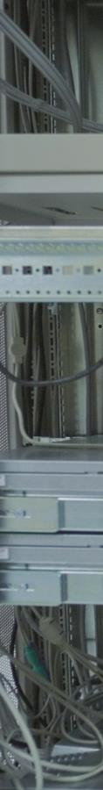
Big Data Analytics
While manufacturers have been generating big data for many years, companies have had limited ability to store, analyze and effectively use all the data that was available.
New big data processing tools are enabling real-time data stream analysis that can provide dramatic improvements in real time problem solving and cost avoidance.
Big data and analytics will be the foundation for areas such as forecasting, proactive maintenance and automation.

Slide 23

Changes in Science
Reductionist thinking and methods form the basis for many areas of modern science
Industry 4.0 require holistic view
Big Data analytics can be used for generation new hypothesis and theories for scientific development
Statistical confidence should not replace development of understanding and wisdom, root-cause analysis and modeling
The biggest challenge for scientist is ability to go outside the comfort zone of their specialization

Slide 24

Dziękuję za Państwa uwagę

